Slide 1

Deep Learning seminar
Sergi Bernet Andrés
DS4DS – La Salle
07-11/03/22

Slide 2
Table of contents – Day 1
Introduction
Dense neurons
History, general knowledge, architectures, framework…
Basic understanding, definition, how and when use it and more.

Slide 3
Table of contents – Day 2
Convolution
What is a convolution and what does it look like, mathematical approach and more

Slide 4
Table of contents – Day 3
Sequential networks
Sequential data/networks, data wrangling, forecasting

Slide 5
Table of contents – Day 4 and 5
Advanced arquitectures and optimization

Slide 6
Seminar evaluation
1st deliverable (08/03): Dense + CNN Deadline: 22/03
Dense
CNN
33%
66%

Slide 7
Seminar evaluation
1st deliverable (08/03): Dense + CNN Deadline: 22/03
2n deliverable (09/03): CNN + Sequential Deadline: 28/03
Dense
CNN
33%
66%
CNN
Sequential
50%
50%

Slide 8
Seminar evaluation
1st deliverable (08/03): Dense + CNN Deadline: 22/03
2n deliverable (09/03): CNN + Sequential Deadline: 28/03
3rd deliverable (11/03): Advanced networks Deadline: 01/04
Dense
CNN
33%
66%
CNN
Sequential
50%
50%
Synthetic data
100%

Slide 9
Introduction

Slide 10
Neurons - Definition
A nerve cell that carries information between the brain and other parts of the body [1]

Slide 11
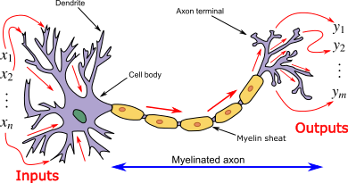
Neurons - Definition
A nerve cell that carries information between the brain and other parts of the body [1]
Biological neuron [2]

Slide 12
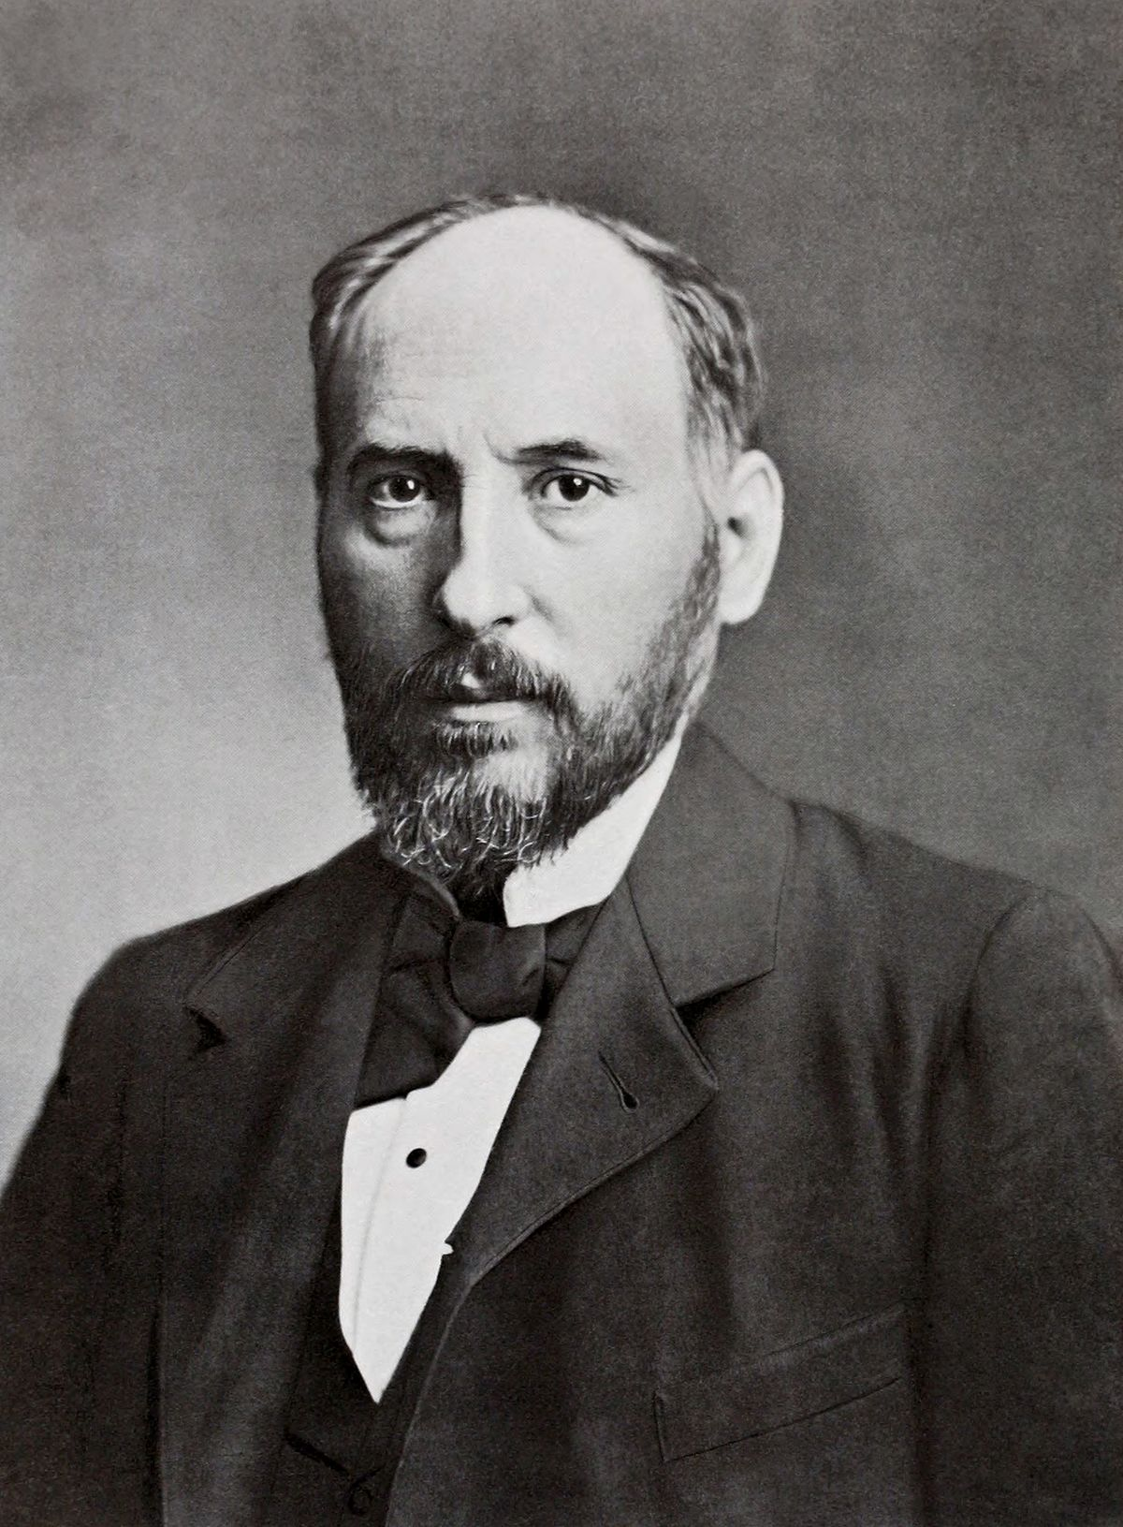
Neurons - The beginning

Slide 13
Neurons - The beginning
Petilla de Aragón (Navarra) 1852 – Madrid 1934
Senator
Medicine field: histology and neuroanatomy
Medicine nobel prize in 1906 with Golgi: nervous system structure
Santiago Ramón y Cajal [3]

Slide 14
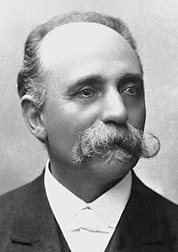
Neurons - The beginning
Petilla de Aragón (Navarra) 1852 – Madrid 1934
Senator
Medicine field: histology and neuroanatomy
Medicine nobel prize in 1906 with Golgi: nervous system structure
Santiago Ramón y Cajal [3]
Camillo Golgi [4]

Slide 15
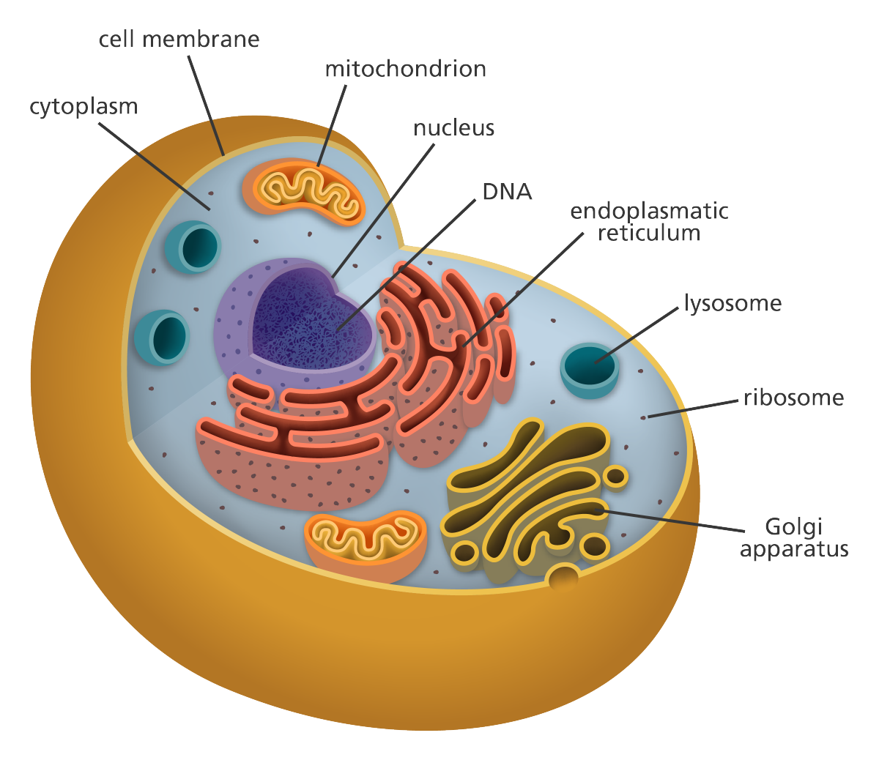
Neurons - The beginning
Petilla de Aragón (Navarra) 1852 – Madrid 1934
Senator
Medicine field: histology and neuroanatomy
Medicine nobel prize in 1906 with Golgi: nervous system structure
Santiago Ramón y Cajal [3]
Camillo Golgi [4]
General cell overview [5]

Slide 16
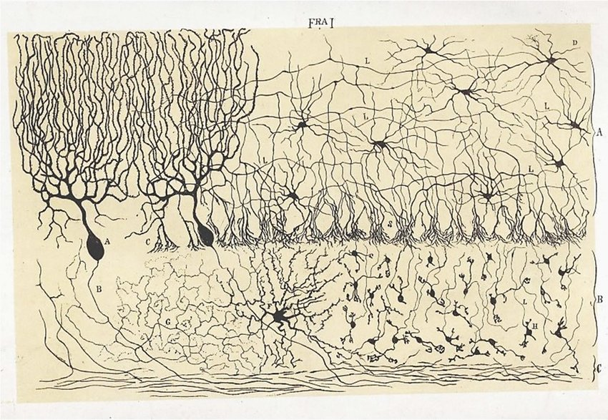
Neurons - The beginning
Petilla de Aragón (Navarra) 1852 – Madrid 1934
Senator
Medicine field: histology and neuroanatomy
Medicine nobel prize in 1906 with Golgi: nervous system structure
Santiago Ramón y Cajal [3]
Camillo Golgi [4]
Espinas dendríticas de las células piramidales, Cajal 1888

Slide 17
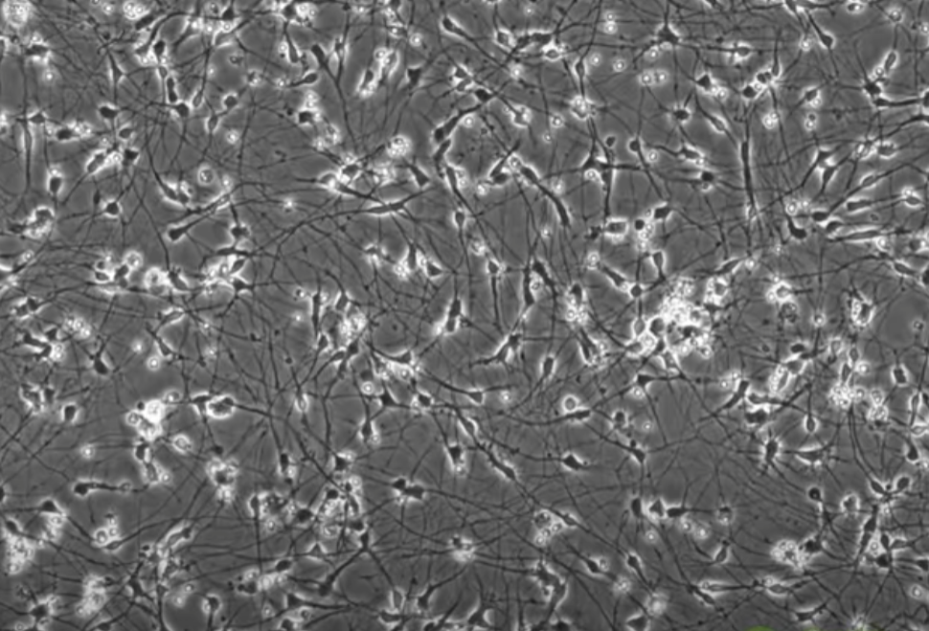
Neurons - The beginning
Petilla de Aragón (Navarra) 1852 – Madrid 1934
Senator
Medicine field: histology and neuroanatomy
Medicine nobel prize in 1906 with Golgi: nervous system structure
Santiago Ramón y Cajal [3]
Camillo Golgi [4]
Neurons video [6]

Slide 18
Neurons - Evolution over time
McCulloch & Pitts (1943)
All or nothing (1/0), excitation occures with a threshold of synaptic activation.
Not realistic but mixed together to obtain a huge calculus power.
Unable to learn.

Slide 19
Neurons - Evolution over time
McCulloch & Pitts (1943)
All or nothing (1/0), excitation occures with a threshold of synaptic activation.
Not realistic but mixed together to obtain a huge calculus power.
Unable to learn.
Hebb learning (1949)
Natural systems born semi-trained.
Whenever an axon is closer enough to other cell to excite it, there's an update to increase activation efficiency.

Slide 20
Neurons - Evolution over time
McCulloch & Pitts (1943)
All or nothing (1/0), excitation occures with a threshold of synaptic activation.
Not realistic but mixed together to obtain a huge calculus power.
Unable to learn.
Hebb learning (1949)
Natural systems born semi-trained.
Whenever an axon is closer enough to other cell to excite it, there's an update to increase activation efficiency.

Slide 21
Neurons - Evolution over time
Perceptron (Rosenblatt, 1958)
Different from McCulloch & Pitts based on probability and inspired from the photoperceptron: some signal excitate and some other inhibit.

Slide 22
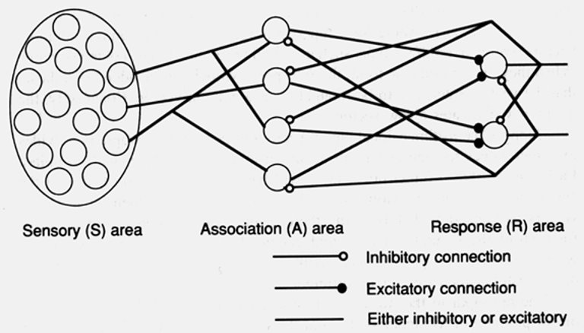
Neurons - Evolution over time
Perceptron (Rosenblatt, 1958)
Different from McCulloch & Pitts based on probability and inspired from the photoperceptron: some signal excitate and some other inhibit.
Photoperceptron [7]

Slide 23
Neurons - Evolution over time
Perceptron modelling (Minsky & Papert, 1969)
Weighted connections between inputs and the neuron, giving 0 or 1 depending on the defined threshold giving place to lineal problems.

Slide 24
Neurons - Evolution over time
Perceptron modelling (Minsky & Papert, 1969)
Weighted connections between inputs and the neuron, giving 0 or 1 depending on the defined threshold giving place to lineal problems.
Adaline (Widrow, 1959)
Adaptative lineal neuron design for processing digital signals.
Adds the learning method (LMS): calculates the error between the output and the expected output aiming to minimize the squared error by adjusting weights.

Slide 25
Neurons - Evolution over time
Perceptron modelling (Minsky & Papert, 1969)
Weighted connections between inputs and the neuron, giving 0 or 1 depending on the defined threshold giving place to lineal problems.
Adaline (Widrow, 1959)
Adaptative lineal neuron design for processing digital signals.
Adds the learning method (LMS): calculates the error between the output and the expected output aiming to minimize the squared error by adjusting weights.
Madaline (Widrow, 1959)
More layers increasing the power with different learning methods.

Slide 26
Neurons - Backpropagation
Different proposals, Werbos (1974), Parker (1985), Rummelhart & McClelland (1986).​
Multilayered supervised network.

Slide 27
Neurons - Backpropagation
Different proposals, Werbos (1974), Parker (1985), Rummelhart & McClelland (1986).​
Multilayered supervised network.
Delta rule
By using gradient descent, update weights to learn.
Gradient descent
Minimizes the loss function by computing the derivatives (gradient), finding out the direction to optimize results.
Learning rate
Approaching speed defined at the beginning of training the network.

Slide 28
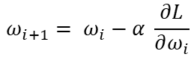
Neurons - Backpropagation
Different proposals, Werbos (1974), Parker (1985), Rummelhart & McClelland (1986).​
Multilayered supervised network.
Delta rule
By using gradient descent, update weights to learn.
Gradient descent
Minimizes the loss function by computing the derivatives (gradient), finding out the direction to optimize results.
Learning rate
Approaching speed defined at the beginning of training the network.
$$ω_{i+1}= ω_{i}−α \frac{∂L}{∂ω_{i}}$$

Slide 29
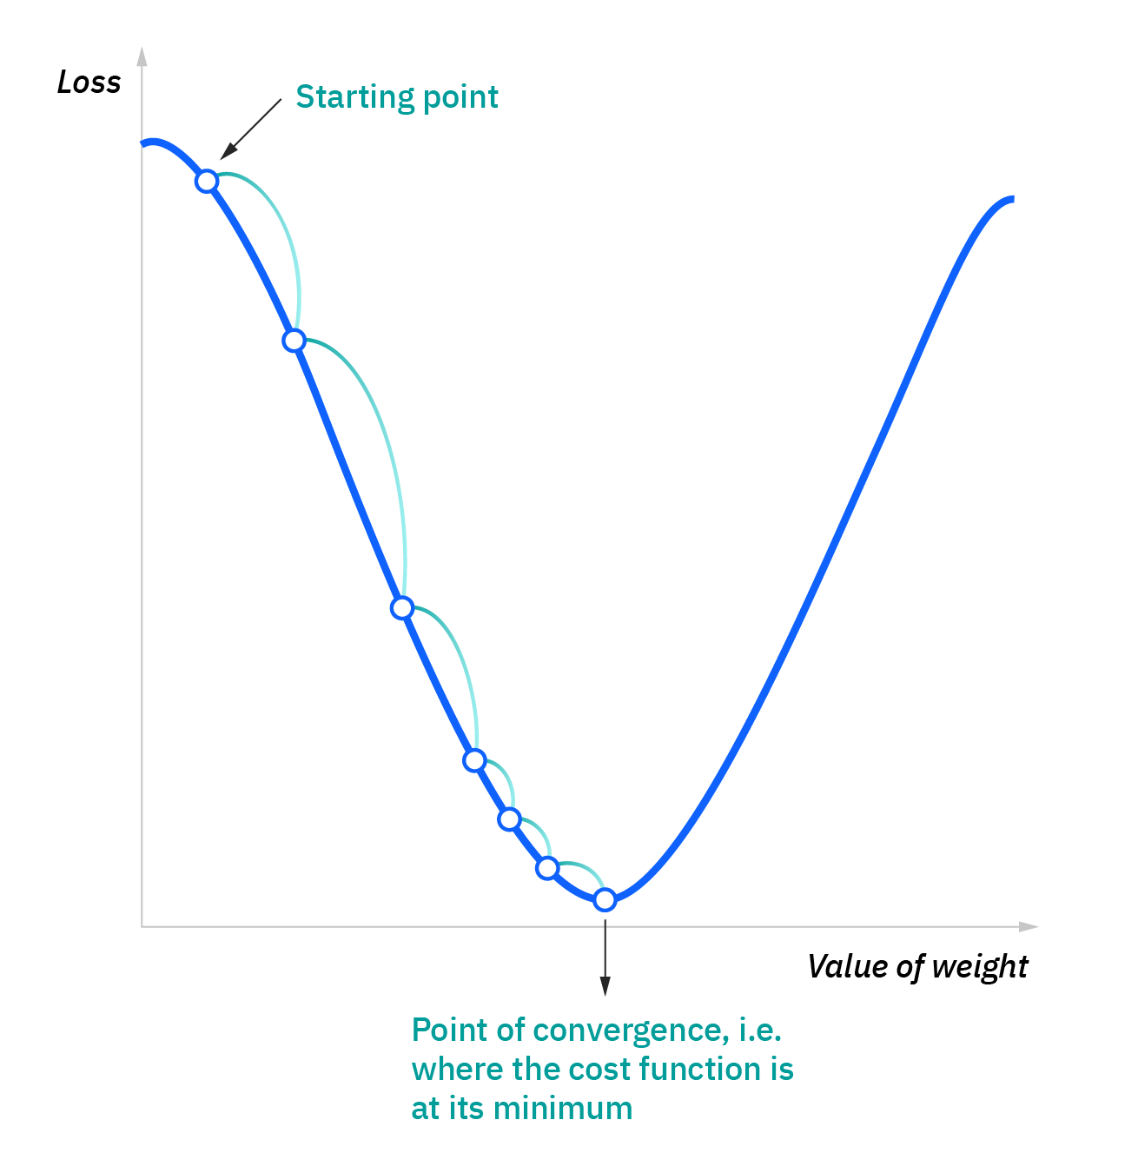
Neurons - Backpropagation
Different proposals, Werbos (1974), Parker (1985), Rummelhart & McClelland (1986).​
Multilayered supervised network.
Delta rule
By using gradient descent, update weights to learn.
Gradient descent
Minimizes the loss function by computing the derivatives (gradient), finding out the direction to optimize results.
Learning rate
Approaching speed defined at the beginning of training the network.
$$ω_{i+1}= ω_{i}−α \frac{∂L}{∂ω_{i}}$$
Proper learning rate [8]

Slide 30
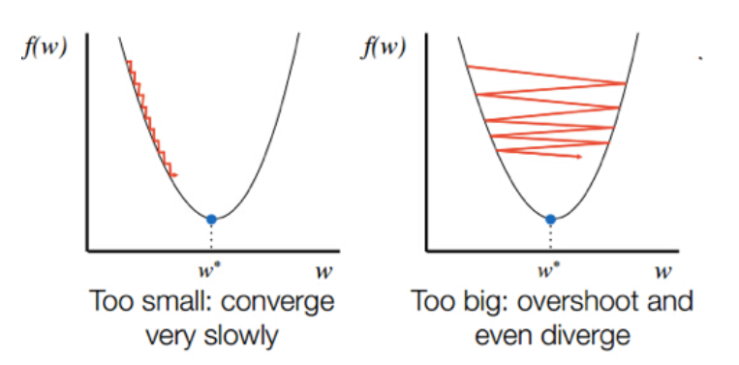
Neurons - Backpropagation
Delta rule
By using gradient descent, update weights to learn.
Gradient descent
Minimizes the loss function by computing the derivatives (gradient), finding out the direction to optimize results.
Learning rate
Approaching speed defined at the beginning of training the network.
Wrong learning rate [9]
$$ω_{i+1}= ω_{i}−α \frac{∂L}{∂ω_{i}}$$

Slide 31
Neurons - Backpropagation
Hidden Layer
Input (1, 2)
(2, 3)
(5, 0)
...
Expected Output (1, 2)
(0, 1)
(1, 0)
...
Input Layer
Output Layer
Input 1
Output 1
Input 2
Output 2

Slide 32
Neurons - Backpropagation
Hidden Layer
Input (1, 2)
(2, 3)
(5, 0)
...
Expected Output (1, 2)
(0, 1)
(1, 0)
...
Output (1, 2)
(0.8, 0.2)
(0.4, 0.6)
...
Input Layer
Output Layer
Input 1
Output 1
Input 2
Output 2

Slide 33
Neurons - Backpropagation
Hidden Layer
Input (1, 2)
(2, 3)
(5, 0)
...
Expected Output (1, 2)
(0, 1)
(1, 0)
...
Output (1, 2)
(0.8, 0.2)
(0.4, 0.6)
...
Input Layer
Output Layer
Input 1
Output 1
Input 2
Output 2
Loss Function: evaluate the weights of the network

Slide 34
Neurons - Backpropagation
Hidden Layer
Input (1, 2)
(2, 3)
(5, 0)
...
Expected Output (1, 2)
(0, 1)
(1, 0)
...
Output (1, 2)
(0.8, 0.2)
(0.4, 0.6)
...
Input Layer
Output Layer
Input 1
Output 1
Backpropagation
Input 2
Output 2
Loss Function: evaluate the weights of the network

Slide 35
Neurons - Backpropagation
Input (1, 2)
(2, 3)
(5, 0)
...
Expected Output (1, 2)
(0, 1)
(1, 0)
...
Output (1, 2)
(0.8, 0.2)
(0.4, 0.6)
...
Hidden Layer
Input Layer
Output Layer
After updating the weights
Input 1
Output 1
Input 2
Output 2

Slide 36
Neurons - Backpropagation
Input (1, 2)
(2, 3)
(5, 0)
...
Expected Output (1, 2)
(0, 1)
(1, 0)
...
Output (1, 2)
(0.8, 0.2)
(0.4, 0.6)
...
Hidden Layer
Input Layer
Output Layer
After updating the weights
Input 1
Output 1
Input (1, 2)
(2, 3)
(5, 0)
...
Expected Output (1, 2)
(0, 1)
(1, 0)
...
Output (1, 2)
(0.5, 0.5)
(0.8, 0.4)
...
Input 2
Output 2

Slide 37
Neurons - Backpropagation
Input (1, 2)
(2, 3)
(5, 0)
...
Expected Output (1, 2)
(0, 1)
(1, 0)
...
Output (1, 2)
(0.8, 0.2)
(0.4, 0.6)
...
Hidden Layer
Input Layer
Output Layer
After updating the weights
Input 1
Output 1
Input (1, 2)
(2, 3)
(5, 0)
...
Expected Output (1, 2)
(0, 1)
(1, 0)
...
Output (1, 2)
(0.5, 0.5)
(0.8, 0.4)
...
Backpropagation
Input 2
Output 2
Loss Function: evaluate the weights of the network

Slide 38
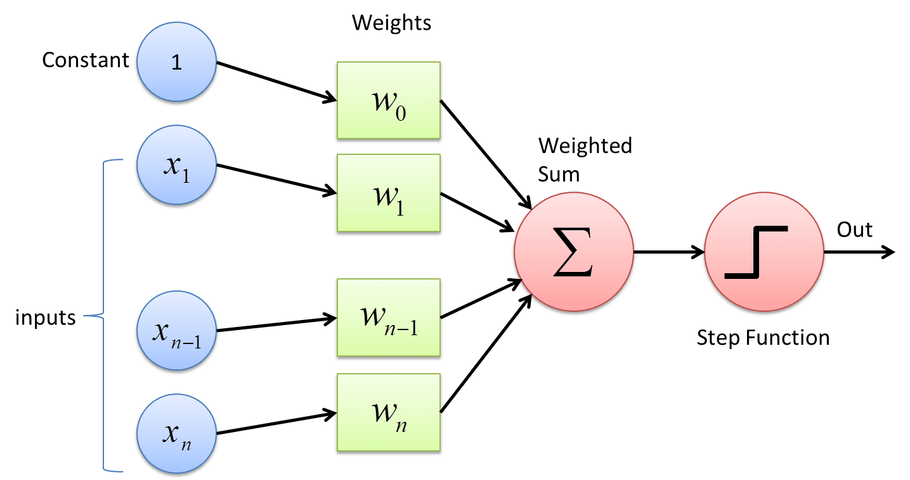
Neurons - Our first approach: Perceptron
Input, output, weights and activation function
Perceptron structure [10]

Slide 39
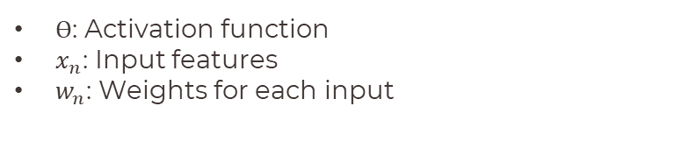

Neurons - Our first approach: Perceptron
Input, output, weights and activation function
$$Out=Ө\sum_{k=0}^{n}{x_{n}w_{n}}$$
$Ө$: Activation function
$x_{n}$: Input features
$w_{n}$: Weights for each input
Perceptron structure [10]

Slide 40
Neurons - First example: Learning neuron
Measurement conversion: cm to inches
Perceptron structure [10]

Slide 41
Neurons - First example: Learning neuron
Measurement conversion: cm to inches
Perceptron structure [10]

Slide 42
Neurons - First example: Learning neuron
Measurement conversion: cm to inches
$$1 cm=0.393701 in$$
Cm | In
5 | 1.9685
15 | 5.9055
25 | 19.685
Perceptron structure [10]
First notebook example: Perceptron 1st example

Slide 43
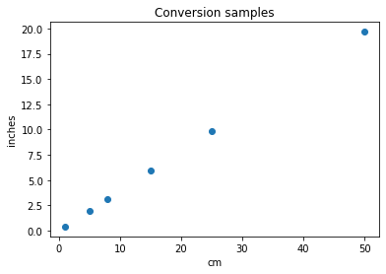
Neurons - First example: Learning neuron

Slide 44
Neurons - First example: Learning neuron

Slide 45
Neurons - First example: Learning neuron
perceptron = tf.keras.layers.Dense(units=1, input_shape=[1])
model = tf.keras.Sequential([perceptron])
model.compile(
optimizer=tf.keras.optimizers.Adam(0.1),
loss='mean_squared_error’)
history = model.fit(cm, inches, epochs=1000, verbose=0)

Slide 46
Neurons - First example: Learning neuron
Definition
perceptron = tf.keras.layers.Dense(units=1, input_shape=[1])
model = tf.keras.Sequential([perceptron])
model.compile(
optimizer=tf.keras.optimizers.Adam(0.1),
loss='mean_squared_error’)
history = model.fit(cm, inches, epochs=1000, verbose=0)

Slide 47
Neurons - First example: Learning neuron
Definition
perceptron = tf.keras.layers.Dense(units=1, input_shape=[1])
model = tf.keras.Sequential([perceptron])
model.compile(
optimizer=tf.keras.optimizers.Adam(0.1),
loss='mean_squared_error’)
history = model.fit(cm, inches, epochs=1000, verbose=0)
Model

Slide 48
Neurons - First example: Learning neuron
Definition
perceptron = tf.keras.layers.Dense(units=1, input_shape=[1])
model = tf.keras.Sequential([perceptron])
model.compile(
optimizer=tf.keras.optimizers.Adam(0.1),
loss='mean_squared_error’)
history = model.fit(cm, inches, epochs=1000, verbose=0)
Model
Compilation

Slide 49
Neurons - First example: Learning neuron
Definition
perceptron = tf.keras.layers.Dense(units=1, input_shape=[1])
model = tf.keras.Sequential([perceptron])
model.compile(
optimizer=tf.keras.optimizers.Adam(0.1),
loss='mean_squared_error’)
history = model.fit(cm, inches, epochs=1000, verbose=0)
Model
Compilation
Training

Slide 50
Neurons - First example: Learning neuron
Definition
perceptron = tf.keras.layers.Dense(units=1, input_shape=[1])
model = tf.keras.Sequential([perceptron])
model.compile(
optimizer=tf.keras.optimizers.Adam(0.1),
loss='mean_squared_error’)
history = model.fit(cm, inches, epochs=1000, verbose=0)
Model
Compilation
Training
Model prediction for 60 cm: 23.622007 Direct conversion value: 23.622060 Connection weight: 0.393700 Connection bias: 0.000007

Slide 51
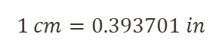
Neurons - First example: Learning neuron
Definition
perceptron = tf.keras.layers.Dense(units=1, input_shape=[1])
model = tf.keras.Sequential([perceptron])
model.compile(
optimizer=tf.keras.optimizers.Adam(0.1),
loss='mean_squared_error’)
history = model.fit(cm, inches, epochs=1000, verbose=0)
Model
Compilation
Training
Model prediction for 60 cm: 23.622007 Direct conversion value: 23.622060 Connection weight: 0.393700 Connection bias: 0.000007
$$1 cm=0.393701 in$$

Slide 52
Neurons - Our first approach: Perceptron
Perceptron structure [10]

Slide 53
Neurons - Our first approach: Perceptron
Plumcake
Perceptron structure [10]

Slide 54
Neurons - Our first approach: Perceptron
Plumcake
Oil – 200g
Sugar – 300g
Vanilla – 1 bean/4 droplets
Eggs – 4 units
Bananas – 4 units
Yeast – 5g
Flour – 375 g
Perceptron structure [10]

Slide 55
Neurons - Our first approach: Perceptron
Plumcake
Oil – 200g
Sugar – 300g
Vanilla – 1 bean/4 droplets
Eggs – 4 units
Bananas – 4 units
Yeast – 5g
Flour – 375 g
Perceptron structure [10]

Slide 56
Neurons - Our first approach: Perceptron
Plumcake
Oil – 200g
Sugar – 300g
Vanilla – 1 bean/4 droplets
Eggs – 4 units
Bananas – 4 units
Yeast – 5g
Flour – 375 g
Non linearity!
Perceptron structure [10]

Slide 57
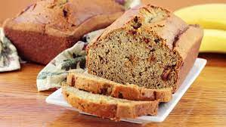
Neurons - Our first approach: Perceptron
Plumcake
Oil – 200g
Sugar – 300g
Vanilla – 1 bean/4 droplets
Eggs – 4 units
Bananas – 4 units
Yeast – 5g
Flour – 375 g
Non linearity!
Perceptron structure [10]
Banana plumcake [11]

Slide 58
Neurons - Our first approach: Perceptron
Titanic dataset
Perceptron structure [10]

Slide 59
Neurons - Our first approach: Perceptron
Titanic dataset
Inputs: ????
Output: ????
Weights: ????
Activation function: ????
Parametrization: ????
Perceptron structure [10]

Slide 60
Neurons - Our first approach: Perceptron
Titanic dataset
Pclass | Sex | Age | Fare | Survived
3 | Male | 25 | 17.80 | 0
2 | Female | 28 | 13 | 1
1 | Male | 52 | 79.65 | 0
Perceptron structure [10]

Slide 61
Neurons - Our first approach: Perceptron
Titanic dataset
Pclass | Sex | Age | Fare | Survived
3 | Male | 25 | 17.80 | 0
2 | Female | 28 | 13 | 1
1 | Male | 52 | 79.65 | 0
Perceptron structure [10]

Slide 62
Neurons - Our first approach: Perceptron
Titanic dataset
Pclass | Sex | Age | Fare | Survived
3 | Male | 25 | 17.80 | 0
2 | Female | 28 | 13 | 1
1 | Male | 52 | 79.65 | 0
Perceptron structure [10]

Slide 63
Neurons - Our first approach: Perceptron
Titanic dataset
Inputs: Features
Output: Survived (1) or not (0)
Weights: ????
Activation function: ????
Parametrization: ????
Perceptron structure [10]

Slide 64
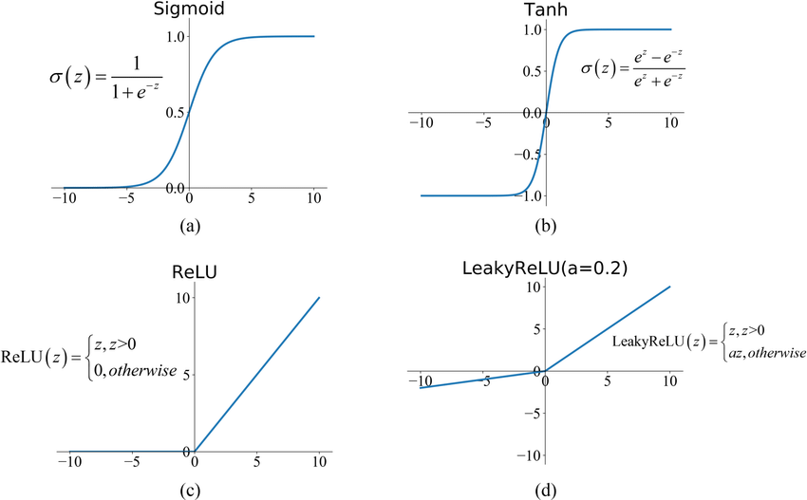
Neurons - Our first approach: Perceptron
Activation function
Defines how the output behaves respect the weighted sum of the inputs
Common activation functions [12]
https://keras.io/api/layers/activations/

Slide 65
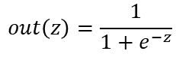
Neurons - Our first approach: Perceptron
Activation function
Defines how the output behaves respect the weighted sum of the inputs
Sigmoid example value
$$out\left(z\right)=\frac{1}{1+e^{−z}}$$
Z | Out(z)
-25 | 1.38 E-11
-5 | 0.0069
0 | 0.5
5 | 0.9933
25 | 0.9999
Common activation functions [12]
https://keras.io/api/layers/activations/

Slide 66
Neurons - Our first approach: Perceptron
Titanic dataset
Inputs: Features
Output: Survived (1) or not (0)
Weights: ????
Activation function: ????
Parametrization (learning rate): ????
Perceptron structure [10]

Slide 67
Neurons - Our first approach: Perceptron
Titanic dataset
Inputs: Features
Output: Survived (1) or not (0)
Weights: ????
Activation function: Sigmoid
Parametrization (learning rate): ????
Perceptron structure [10]

Slide 68
Neurons - Our first approach: Perceptron
Titanic dataset
Inputs: Features
Output: Survived (1) or not (0)
Weights: ????
Activation function: Sigmoid
Parametrization (learning rate): 0.01, 0.001 …
Perceptron structure [10]

Slide 69
Neurons - Our first approach: Perceptron
Titanic dataset
Inputs: Features
Output: Survived (1) or not (0)
Weights: ????
Activation function: Sigmoid
Parametrization (learning rate): 0.01, 0.001 …
Perceptron structure [10]
2nd notebook example: Complete perceptron

Slide 70

TensorFlow

Slide 71
TensorFlow
Open-source package for Deep Learning (Google)
Contains common layers for our networks.
High performance operations based on tensors.
Prepared for running in graphical processing units (GPUs)

Slide 72

TensorFlow
Open-source package for Deep Learning (Google)
Contains common layers for our networks.
High performance operations based on tensors.
Prepared for running in graphical processing units (GPUs)
Intel I9 7960XE [13]

Slide 73
TensorFlow
Open-source package for Deep Learning (Google)
Contains common layers for our networks.
High performance operations based on tensors.
Prepared for running in graphical processing units (GPUs)
Model | TFLOPS
I9 7960XE | 1.3
Intel I9 7960XE [13]

Slide 74
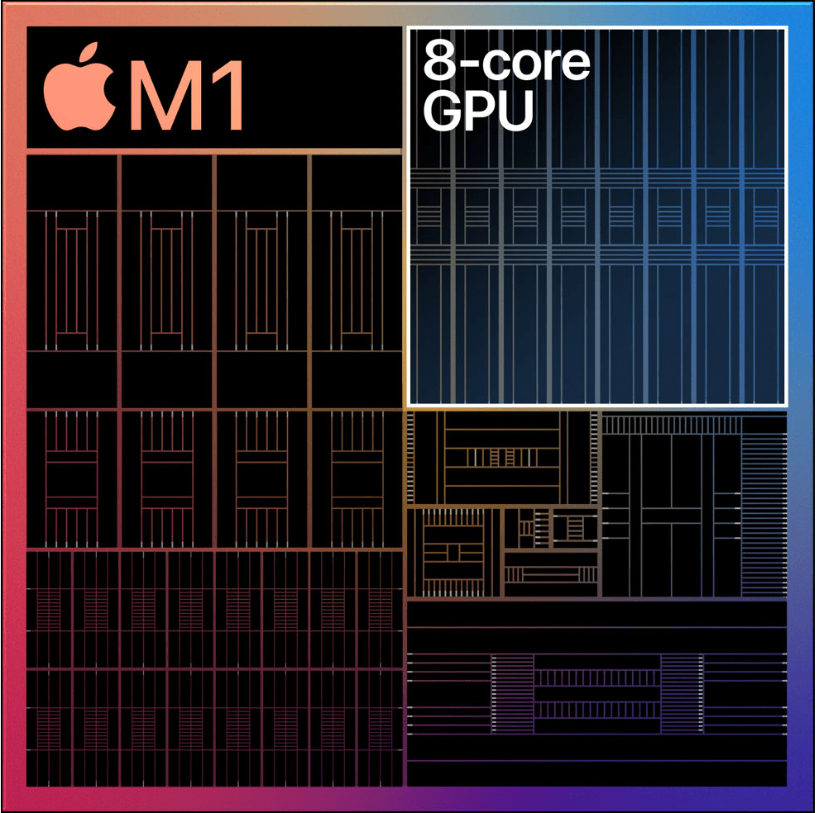
TensorFlow
Open-source package for Deep Learning (Google)
Contains common layers for our networks.
High performance operations based on tensors.
Prepared for running in graphical processing units (GPUs)
Model | TFLOPS
I9 7960XE | 1.3
Intel I9 7960XE [13]
M1 chip [14]

Slide 75
TensorFlow
Open-source package for Deep Learning (Google)
Contains common layers for our networks.
High performance operations based on tensors.
Prepared for running in graphical processing units (GPUs)
Model | TFLOPS
I9 7960XE | 1.3
M1 chip | 2.6
M1 pro | 4.6
Intel I9 7960XE [13]
M1 chip [14]

Slide 76
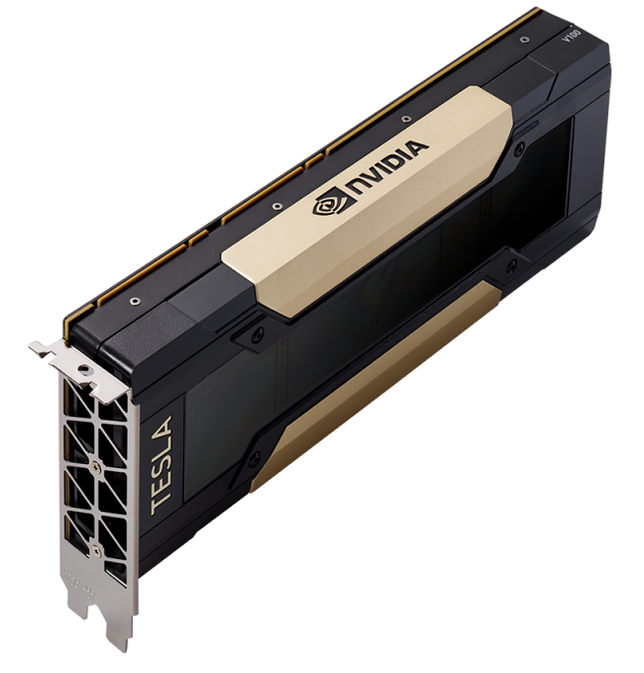
TensorFlow
Open-source package for Deep Learning (Google)
Contains common layers for our networks.
High performance operations based on tensors.
Prepared for running in graphical processing units (GPUs)
Model | TFLOPS
I9 7960XE | 1.3
M1 chip | 2.6
M1 pro | 4.6
Intel I9 7960XE [13]
M1 chip [14]
Nvdia Tesla V100 [15]

Slide 77
TensorFlow
Open-source package for Deep Learning (Google)
Contains common layers for our networks.
High performance operations based on tensors.
Prepared for running in graphical processing units (GPUs)
Model | TFLOPS
I9 7960XE | 1.3
M1 chip | 2.6
M1 pro | 4.6
V100 | 7
Intel I9 7960XE [13]
M1 chip [14]
Nvdia Tesla V100 [15]

Slide 78
TensorFlow
Open-source package for Deep Learning (Google)
Contains common layers for our networks.
High performance operations based on tensors.
Prepared for running in graphical processing units (GPUs)
Model | TFLOPS
I9 7960XE | 1.3
M1 chip | 2.6
M1 pro | 4.6
V100 | 7
V100 tensor | 110
Intel I9 7960XE [13]
M1 chip [14]
Nvdia Tesla V100 [15]

Slide 79

Hands on!

Slide 80

Coffee break

Slide 81
What is deep learning ?

Slide 82
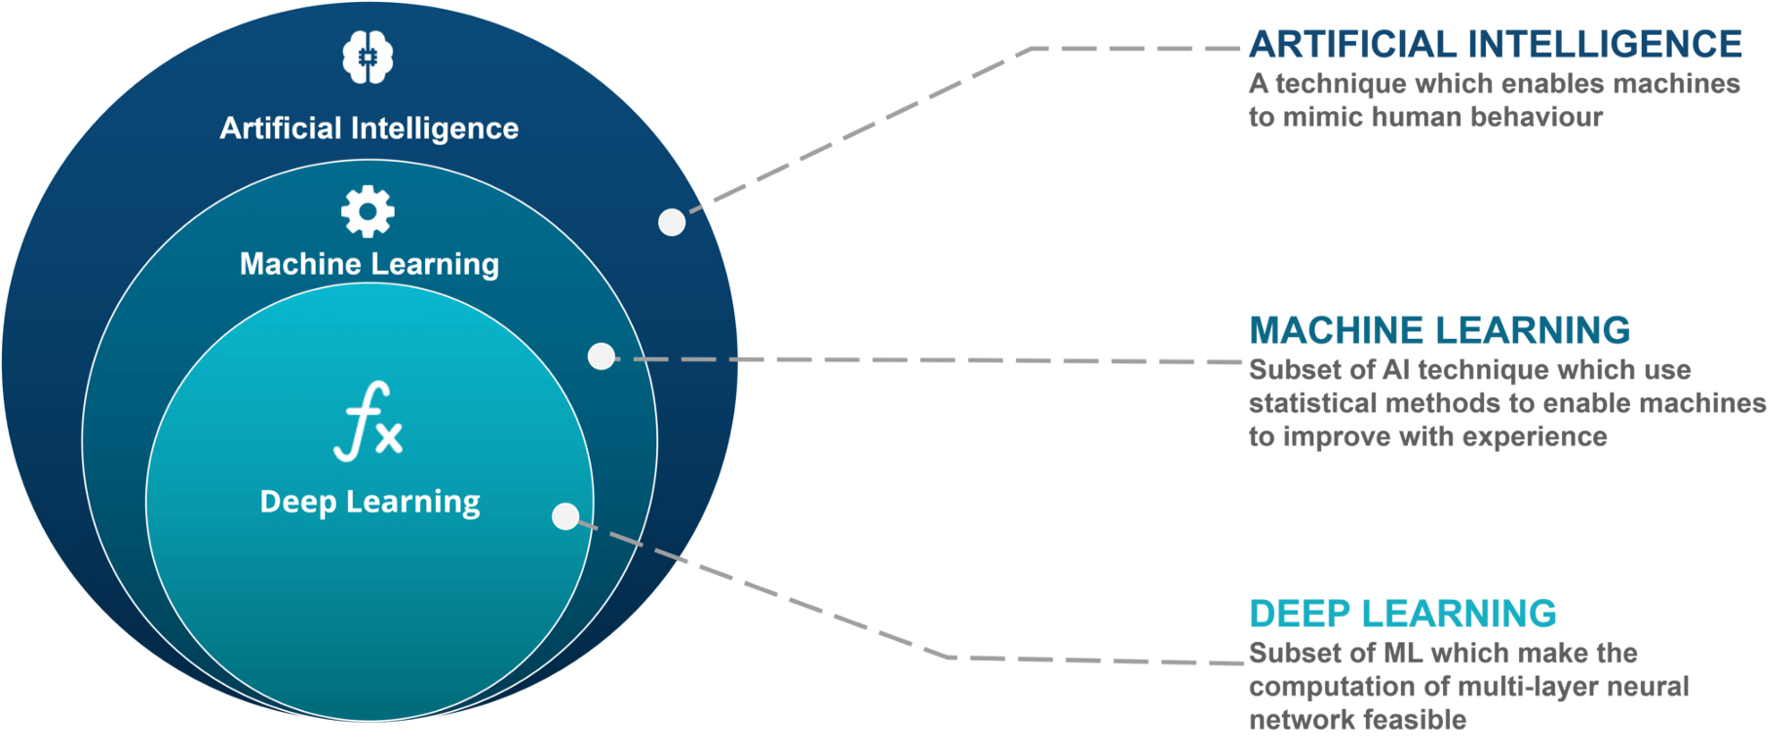
Global overview

Slide 83
Deep Learning architectures
Perceptron
Lineal/Dense
Convolutional
Recurrent/Sequential
Specific configurations

Slide 84

Deep Learning architectures
Perceptron
Lineal/Dense
Convolutional
Recurrent/Sequential
Specific configurations
https://www.asimovinstitute.org/neural-network-zoo/

Slide 85
There’s (almost) a network for each problem
Titanic example
Pattern recognition
Filtering noise in signal processing
Image segmentation
Synthetic data
Natural Language Processing
And many more!

Slide 86
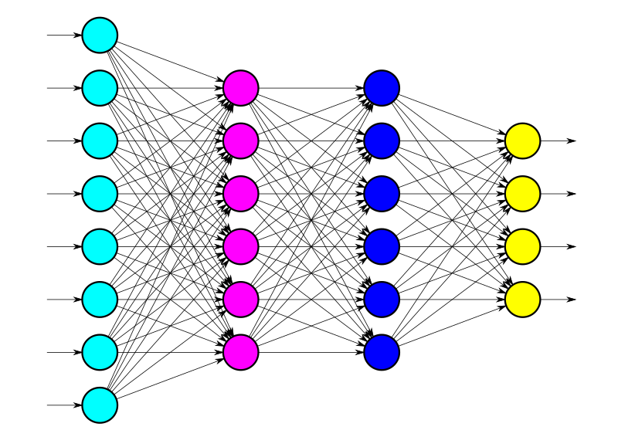
Dense networks

Slide 87
Concept
Concatenation of multiple perceptrons in cascade, called layers in our framework.

Slide 88
Concept
Concatenation of multiple perceptrons in cascade, called layers in our framework.

Slide 89
Concept
Concatenation of multiple perceptrons in cascade, called layers in our framework.
Perceptron 1

Slide 90
Concept
Concatenation of multiple perceptrons in cascade, called layers in our framework.
Perceptron 1
Perceptron 2

Slide 91
Concept
Concatenation of multiple perceptrons in cascade, called layers in our framework.
Perceptron 1
Perceptron 2
Perceptron k

Slide 92
Concept
Concatenation of multiple perceptrons in cascade, called layers in our framework.
Input layer

Slide 93
Concept
Concatenation of multiple perceptrons in cascade, called layers in our framework.
Input layer
Hidden layer 1
Hidden layer 2

Slide 94
Concept
Concatenation of multiple perceptrons in cascade, called layers in our framework.
Input layer
Hidden layer 1
Hidden layer 2
Output layer

Slide 95
Building up the structure
Network defined by its sequentiality, defining layer after layer as a whole.

Slide 96
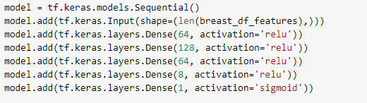
Building up the structure
Network defined by its sequentiality, defining layer after layer as a whole.

Slide 97
Building up the structure
Network defined by its sequentiality, defining layer after layer as a whole.
Define sequential model

Slide 98
Building up the structure
Network defined by its sequentiality, defining layer after layer as a whole.
Define sequential model
Define network’s input shape

Slide 99
Building up the structure
Network defined by its sequentiality, defining layer after layer as a whole.
Define sequential model
Define network’s input shape
Add as many layers as we want

Slide 100
Building up the structure
Network defined by its sequentiality, defining layer after layer as a whole.
Define sequential model
Define network’s input shape
Add as many layers as we want
Add the output layer with the corresponding activation function

Slide 101
Building up the structure
Network defined by its sequentiality, defining layer after layer as a whole.
Define sequential model
Define network’s input shape
Add as many layers as we want
Add the output layer with the corresponding activation function
Neurons per layer

Slide 102
Building up the structure
Network defined by its sequentiality, defining layer after layer as a whole.
Define sequential model
Define network’s input shape
Add as many layers as we want
Add the output layer with the corresponding activation function
Neurons per layer
Activation function

Slide 103
Building up the structure
Network defined by its sequentiality, defining layer after layer as a whole.
Define sequential model
Define network’s input shape
Add as many layers as we want
Add the output layer with the corresponding activation function
Neurons per layer
Activation function
Activation functions can also be defined as independent layers !

Slide 104
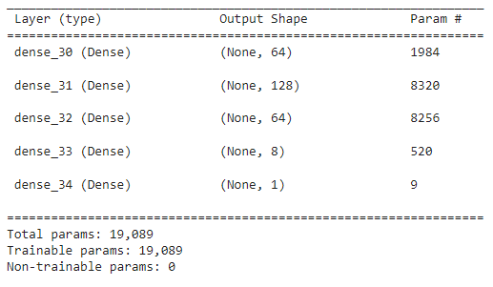
Building up the structure - summary
Network defined by its sequentiality, defining layer after layer as a whole.
Network summary

Slide 105
Building up the structure - summary
Network defined by its sequentiality, defining layer after layer as a whole.
Network summary

Slide 106
Building up the structure - summary
Network defined by its sequentiality, defining layer after layer as a whole.
Network summary

Slide 107
Structure prepared: last steps
Network defined by its sequentiality, defining layer after layer as a whole.

Slide 108
Structure prepared: last steps
Network defined by its sequentiality, defining layer after layer as a whole.
Compile model defining: optimizer, loss and metric to consider.

Slide 109
Structure prepared: last steps
Network defined by its sequentiality, defining layer after layer as a whole.
Compile model defining: optimizer, loss and metric to consider.
Train it.

Slide 110
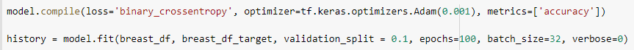
Structure prepared: last steps
Network defined by its sequentiality, defining layer after layer as a whole.
Compile model defining: optimizer, loss and metric to consider.
Train it.

Slide 111
Structure prepared: last steps
Network defined by its sequentiality, defining layer after layer as a whole.
Compile model defining: optimizer, loss and metric to consider.
Train it.

Slide 112
Structure prepared: last steps
Network defined by its sequentiality, defining layer after layer as a whole.
Compile model defining: optimizer, loss and metric to consider.
Train it.

Slide 113
Structure prepared: last steps
Network defined by its sequentiality, defining layer after layer as a whole.
Compile model defining: optimizer, loss and metric to consider.
Train it.
Data
Expected output (0/1)

Slide 114
Structure prepared: last steps
Network defined by its sequentiality, defining layer after layer as a whole.
Compile model defining: optimizer, loss and metric to consider.
Train it.
Data
Expected output (0/1)
https://keras.io/api/optimizers/
https://keras.io/api/losses/
https://keras.io/api/metrics/

Slide 115
Structure prepared: last steps
Network defined by its sequentiality, defining layer after layer as a whole.
Compile model defining: optimizer, loss and metric to consider.
Train it.
Evaluate and adjust.

Slide 116
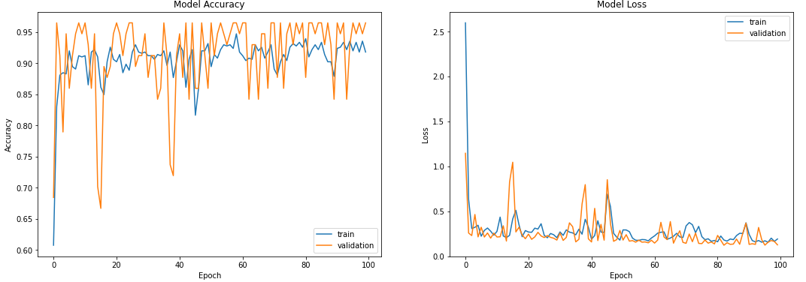
Structure prepared: last steps
Network defined by its sequentiality, defining layer after layer as a whole.
Compile model defining: optimizer, loss and metric to consider.
Train it.
Evaluate and adjust.

Slide 117

Dense networks - Breast cancer dataset [x]
Classification dataset from UCI repository provided on November 1995.
569 Instances described with 32 attributes.
Dataset without nulls.
Used on relevant papers in medical literature.
Preloaded in sklearn, easy to obtain and process.
University of California Irvine

Slide 118
Dense networks - Breast cancer dataset [x]
Classification dataset from UCI repository provided on November 1995.
569 Instances described with 32 attributes.
Dataset without nulls.
Used on relevant papers in medical literature.
Preloaded in sklearn, easy to obtain and process.
University of California Irvine
First questions to ask
Inputs: ????
Inputs types: ????
Is preprocessing required:????
Output: ????
Output activation function: ????
Layers: ????
Parametrization: ????

Slide 119
Dense networks - Breast cancer dataset [x]
Classification dataset from UCI repository provided on November 1995.
569 Instances described with 32 attributes.
Dataset without nulls.
Used on relevant papers in medical literature.
Preloaded in sklearn, easy to obtain and process.
University of California Irvine
First questions to ask
Inputs: < 31 attributes
Inputs types: ????
Is preprocessing required:????
Output: ????
Output activation function: ????
Layers: ????
Parametrization: ????

Slide 120
Dense networks - Breast cancer dataset [x]
Classification dataset from UCI repository provided on November 1995.
569 Instances described with 32 attributes.
Dataset without nulls.
Used on relevant papers in medical literature.
Preloaded in sklearn, easy to obtain and process.
University of California Irvine
First questions to ask
Inputs: < 31 attributes
Inputs types: Mostly numerical
Is preprocessing required:????
Output: ????
Output activation function: ????
Layers: ????
Parametrization: ????

Slide 121
Dense networks - Breast cancer dataset [x]
Classification dataset from UCI repository provided on November 1995.
569 Instances described with 32 attributes.
Dataset without nulls.
Used on relevant papers in medical literature.
Preloaded in sklearn, easy to obtain and process.
University of California Irvine
First questions to ask
Inputs: < 31 attributes
Inputs types: Mostly numerical
Is preprocessing required: Not this time!
Output: ????
Output activation function: ????
Layers: ????
Parametrization: ????

Slide 122
Dense networks - Breast cancer dataset [x]
Classification dataset from UCI repository provided on November 1995.
569 Instances described with 32 attributes.
Dataset without nulls.
Used on relevant papers in medical literature.
Preloaded in sklearn, easy to obtain and process.
University of California Irvine
First questions to ask
Inputs: < 31 attributes
Inputs types: Mostly numerical
Is preprocessing required: Not this time!
Output: 0/1 (benign/malign)
Output activation function: ????
Layers: ????
Parametrization: ????

Slide 123
Dense networks - Breast cancer dataset [x]
Classification dataset from UCI repository provided on November 1995.
569 Instances described with 32 attributes.
Dataset without nulls.
Used on relevant papers in medical literature.
Preloaded in sklearn, easy to obtain and process.
University of California Irvine
First questions to ask
Inputs: < 31 attributes
Inputs types: Mostly numerical
Is preprocessing required: Not this time!
Output: 0/1 (benign/malign)
Output activation function: Sigmoid
Layers: ????
Parametrization: ????

Slide 124
Dense networks - Breast cancer dataset [x]
Classification dataset from UCI repository provided on November 1995.
569 Instances described with 32 attributes.
Dataset without nulls.
Used on relevant papers in medical literature.
Preloaded in sklearn, easy to obtain and process.
University of California Irvine
First questions to ask
Inputs: < 31 attributes
Inputs types: Mostly numerical
Is preprocessing required: Not this time!
Output: 0/1 (benign/malign)
Output activation function: Sigmoid
Layers: Up to you!
Parametrization: ????

Slide 125
Dense networks - Breast cancer dataset [x]
Classification dataset from UCI repository provided on November 1995.
569 Instances described with 32 attributes.
Dataset without nulls.
Used on relevant papers in medical literature.
Preloaded in sklearn, easy to obtain and process.
University of California Irvine
First questions to ask
Inputs: < 31 attributes
Inputs types: Mostly numerical
Is preprocessing required: Not this time!
Output: 0/1 (benign/malign)
Output activation function: Sigmoid
Layers: Up to you!
Parametrization: Up to you!

Slide 126
Hands on!

Slide 127
References
[1] - Neuron definition (Cambridge): https://dictionary.cambridge.org/dictionary/english/neuron?q=Neuron
[2] - Biological Neuron: https://medium.com/sanju-notes/introduction-to-perceptron-78a386f4bd73
[3] - Santiago Ramón y Cajal: https://es.wikipedia.org/wiki/Santiago_Ram%C3%B3n_y_Cajal
[4] - Camillo Golgi: https://es.wikipedia.org/wiki/Camillo_Golgi
[5] - General cell overview: https://www.yourgenome.org/facts/what-is-a-cell
[6] - Youtube neurons video: https://www.youtube.com/watch?v=in2ig3c9lCQ
[7] - Photoperceptron: Figura 1.12 pág 24 Introducción a la tecnología ANS, Redes neuronales Algoritmos, aplicaciones y técnicas de programación. James A Freeman / David M. Skapura 1993
[8] - Proper learning rate: https://www.ibm.com/cloud/learn/gradient-descent
[9] - Wrong learning rate: https://laptrinhx.com/artificial-neural-networks-part-3-loss-and-cost-functions-and-gradient-descent-507013705/
[10] - Perceptron structure: https://deepai.org/machine-learning-glossary-and-terms/perceptron
[11] - Banana plumcake: https://www.beiker.es/r/plum-cake-de-platano-miel-y-nueces

Slide 128
References
[12] - Common activation functions: https://www.researchgate.net/figure/Commonly-used-activation-functions-a-Sigmoid-b-Tanh-c-ReLU-and-d-LReLU_fig3_335845675
[13] - Intel I9 EX: https://www.anandtech.com/Show/Index/11839?cPage=2&all=False&sort=0&page=16&slug=intel-core-i9-7980xe-and-core-i9-7960x-review
[14] - M1 chip: https://www.macstories.net/news/apple-unveils-new-m1-apple-silicon-chip-for-macs/
[15] - Nvidia Tesla V100: https://www.flytech.es/producto/nvidia-tesla-v100-32gb-hbm2-pcie-passive/
[x] - Breast Cancer dataset: Dua, D. and Graff, C. (2019). UCI Machine Learning Repository [http://archive.ics.uci.edu/ml]. Irvine, CA: University of California, School of Information and Computer Science.

Slide 129
Thanks
Do you have any questions?
Sergi.bernet@salle.url.edu

